Slide 1
Exception handling and Multithreading

Slide 2
4.1 Errors and Exceptions
4.1.1 try-catch
4.1.2 throw
4.1.3 throws
4.1.4 final
Errors:
Errors in Java are serious conditions that typically cannot be recovered by the program (e.g., running out of memory, stack overflow). They are represented by the Error class and its subclasses. Errors are usually external to the application and should not be handled using code.
Exceptions:
Exceptions are conditions that can be handled within the program. They occur when something goes wrong during program execution (such as dividing by zero, file not found, etc.), and are instances of the Exception class or its subclasses. Exception handling enables Java programs to handle these problems gracefully and continue execution.
4.1.1 try-catch
The try-catch block is used to handle exceptions. Code that may throw an exception is placed in the try block; errors are caught and handled in the catch block.

Slide 3
Syntax:
try {
// code that may throw exception
} catch (ExceptionType e) {
// exception handling code
}
Example:
try {
int result = 10 / 0; // This will throw ArithmeticException
} catch (ArithmeticException e) {
System.out.println("Exception caught: " + e);
}
Output:
Exception caught: java.lang.ArithmeticException: / by zero.

Slide 4
4.1.2 throw
The throw keyword is used to explicitly throw an exception from a method or a block of code.
Syntax:
throw new ExceptionType("Error message");
Example:
public static void checkAge(int age) {
if (age < 18) {
throw new ArithmeticException("Age is not valid for voting");
} else {
System.out.println("You are eligible to vote");
}
}
If you call checkAge(15);, it will throw an exception.

Slide 5
4.1.3 throws
The throws keyword is used in a method’s signature to declare the exceptions that might be thrown by the method. It tells the caller of the method to handle those exceptions.
Syntax:
void methodName() throws ExceptionType1, ExceptionType2 {
// method code
}
Example:
void myMethod() throws IOException {
// code that may throw IOException
}
If a method declares throws IOException, the caller must handle or declare it as well.

Slide 6
4.1.4 final
The final keyword is used to restrict modification.
Final variable: its value cannot be changed (constant).
Final method: cannot be overridden by subclasses.
Final class: cannot be subclassed.
Example:
final int a = 5;
a = 10; // Error: cannot assign a value to final variable a
final void display() {
System.out.println("This cannot be overridden");
}

Slide 7
4.2 User defined exceptions
A user defined exception in Java (also called a custom exception) is an exception created by the programmer to handle specific, application-related error situations that are not covered by Java’s built-in exceptions. This involves creating a new class that extends Exception (for checked exceptions) or RuntimeException (for unchecked exceptions), and then using it like other exceptions.
How to Create and Use User Defined Exceptions
Step 1: Define your custom exception class by extending Exception:
Java
class MyException extends Exception {
public MyException(String message) {
super(message);
}
}
Step 2: Use your exception class in code:

Slide 8
public class TestException {
public static void main(String[] args) {
try {
throw new MyException("This is a custom exception!");
} catch (MyException e) {
System.out.println("Caught custom exception: " + e.getMessage());
}
}
}
Output:
Caught custom exception: This is a custom exception!
Real Example: Age Validation
// Step 1: Create User-defined Exception
class MyException extends Exception {
MyException(String message) {
super(message); // pass message to Exception class
}
}

Slide 9
// Step 2: Use the Exception
public class pack {
static void checkNumber(int num) throws MyException {
if (num < 1) {
throw new MyException("Number is less than 1");
} else {
System.out.println("Number is: " + num);
}
}
public static void main(String args[]) {
try {
checkNumber(0); // triggers exception
} catch (MyException e) {
System.out.println("Caught Exception: " + e.getMessage());
}
try {
checkNumber(5); // no exception
} catch (MyException e) {
System.out.println(e.getMessage());
}
}
}

Slide 10
Output:
Caught Exception: Number is less than 1
Number is: 5
4.3 Multithreading
4.3.1 Thread life cycle
4.3.2 Creating thread
4.3.3 Thread priority
Multithreading is a Java feature that allows concurrent execution of two or more parts of a program to maximize CPU utilization and responsiveness.
4.3.1 Thread Life Cycle
A thread in Java goes through various states:

Slide 11
State | Description
New | Thread is created but not started.
Runnable | Thread is ready to run and waiting for CPU allocation.
Running | Thread is executing.
Blocked/Waiting/Timed Waiting | Thread is paused, waiting for some event (resource, time, notify).
Terminated (Dead) | Thread has finished execution or stopped due to an exception.
Transitions between these states are managed by the thread scheduler and happen based on program events and CPU availability.

Slide 12
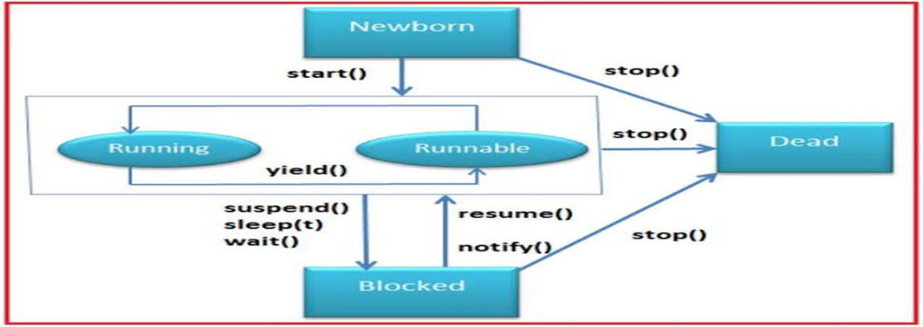

Slide 13
4.3.2 Creating Threads
Two main ways to create threads:
Extending the Thread class
class MyThread extends Thread {
public void run() {
System.out.println("Thread running");
}
}
public class Test {
public static void main(String[] args) {
MyThread t1 = new MyThread();
t1.start(); // start() begins new thread execution and calls run()
}
}

Slide 14
.
Implementing Runnable interface
class MyRunnable implements Runnable {
public void run() {
System.out.println("Runnable thread running");
}
}
public class TestRunnable {
public static void main(String[] args) {
Thread t1 = new Thread(new MyRunnable());
t1.start();
}
}
The start() method starts a new thread and calls the run() method internally.

Slide 15
4.3.3 Thread Priority in Java
Thread priority is a mechanism that helps the Java thread scheduler decide the order in which threads are executed when multiple threads are runnable. Threads with higher priority are preferred to be executed before threads with lower priority, though this behavior depends on the JVM and underlying OS and is not strictly guaranteed.
Key Points about Thread Priority
Priority values range from 1 to 10:
  MIN_PRIORITY (1): Lowest priority
  NORM_PRIORITY (5): Default priority assigned to new threads
  MAX_PRIORITY (10): Highest priority
Threads inherit the priority of the thread that created them unless explicitly changed.
Methods:
  getPriority(): Returns the priority of a thread.
  setPriority(int newPriority): Sets the thread's priority; throws IllegalArgumentException if outside 1-10 range.

Slide 16
Example of Thread Priority
class PriorityDemo extends Thread {
public void run() {
System.out.println(Thread.currentThread().getName() + " is running with priority: " + Thread.currentThread().getPriority());
}
}
public class ThreadPriorityExample {
public static void main(String[] args) {
PriorityDemo t1 = new PriorityDemo();
PriorityDemo t2 = new PriorityDemo();
PriorityDemo t3 = new PriorityDemo();
t1.setPriority(Thread.MIN_PRIORITY);
t2.setPriority(Thread.NORM_PRIORITY);
t3.setPriority(Thread.MAX_PRIORITY);
t1.start();
t2.start();
t3.start();

Slide 17
System.out.println("Priority of t1: " + t1.getPriority());
System.out.println("Priority of t2: " + t2.getPriority());
System.out.println("Priority of t3: " + t3.getPriority());
}
}

